Slide 1
Skilling up
How to stay relevant in an age of constant disruption

Slide 2
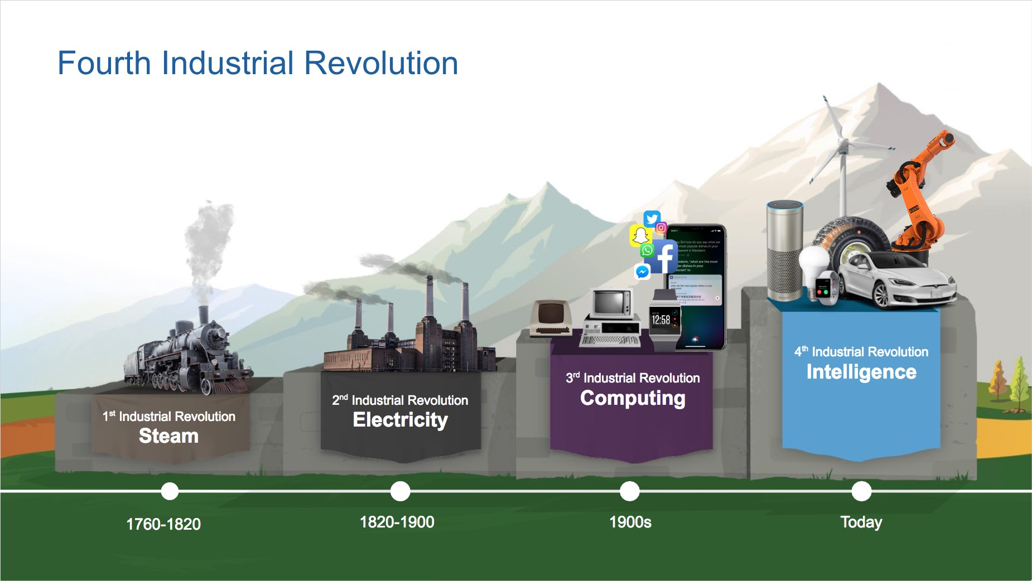

History of Industrial Revolution
Image courtesy of Medium.com

Slide 3
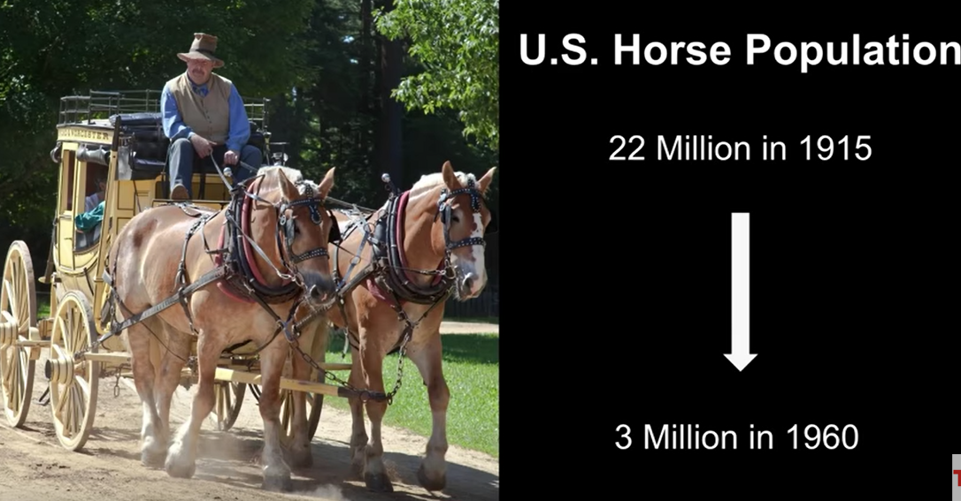
Victims of the 1st Industrial Revolution
U.S. Horse Population
22 Million in 1915
3 Million in 1960
Image courtesy of Shutterstock

Slide 4
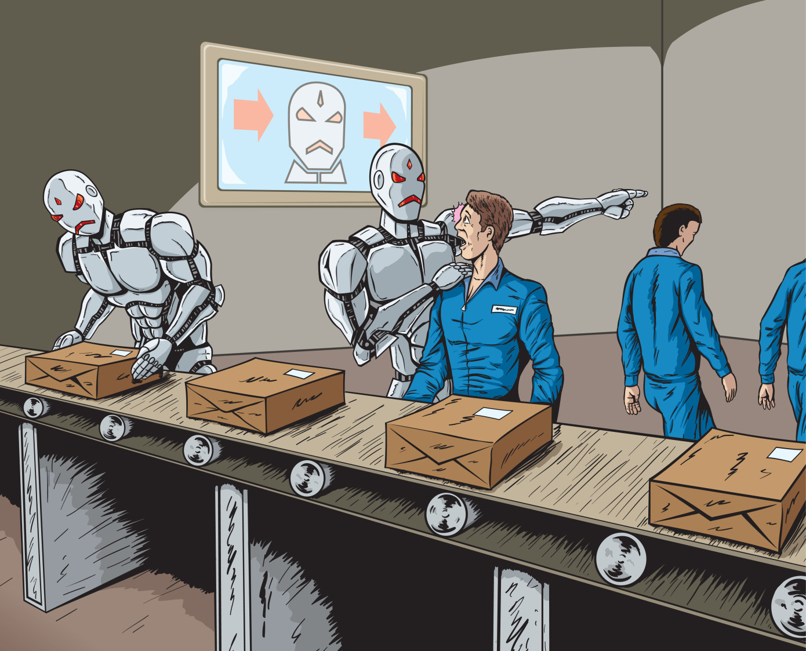
Victims of the 4th Industrial Revolution
Just like Horses in the first, could Humans be victims of the fourth Industrial Revolution?
Image courtesy of TechCrunch
Image courtesy of Shutterstock

Slide 5
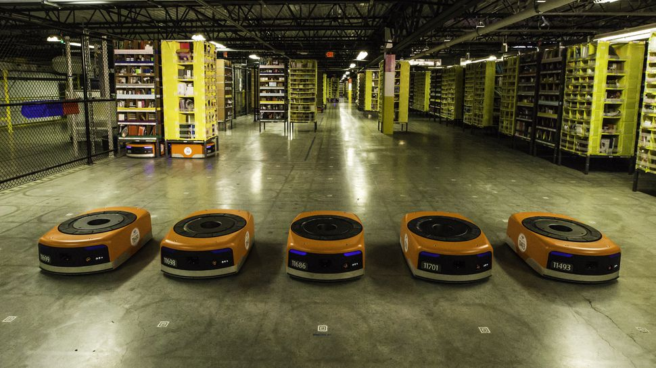
Robots in Amazon Warehouse
These have began to replace Humans

Slide 6
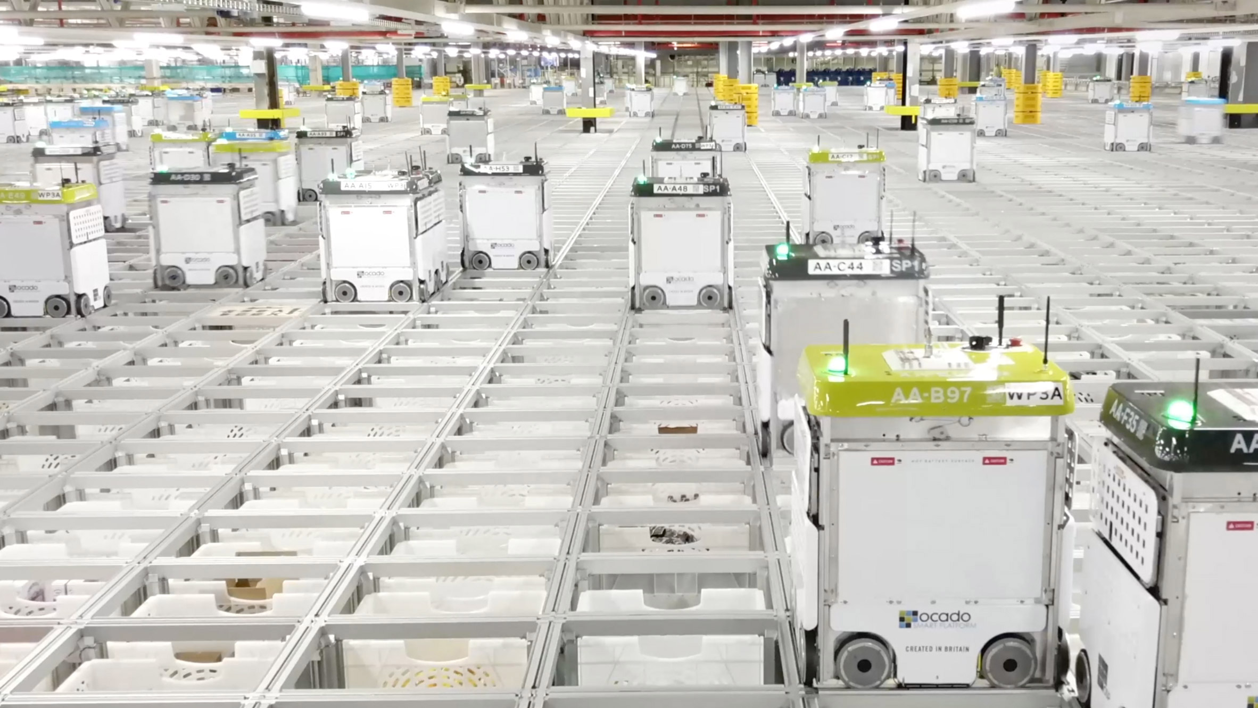
Robots in Ocado Warehouse
These have began to replace Humans

Slide 7
Get Ready for the Intersection of Human and Robots

Slide 8
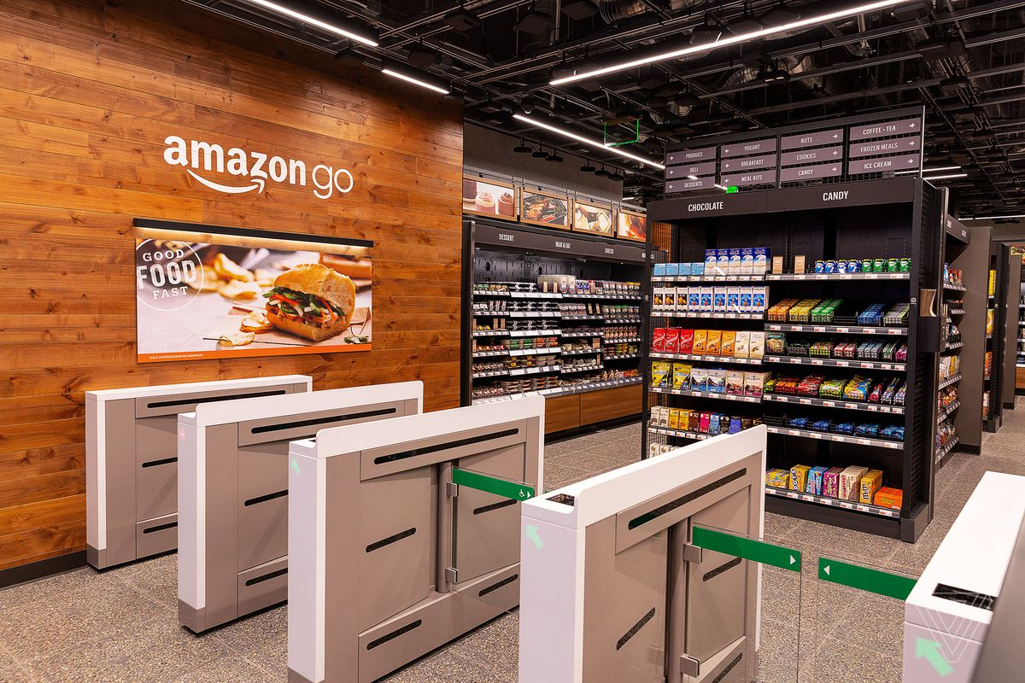
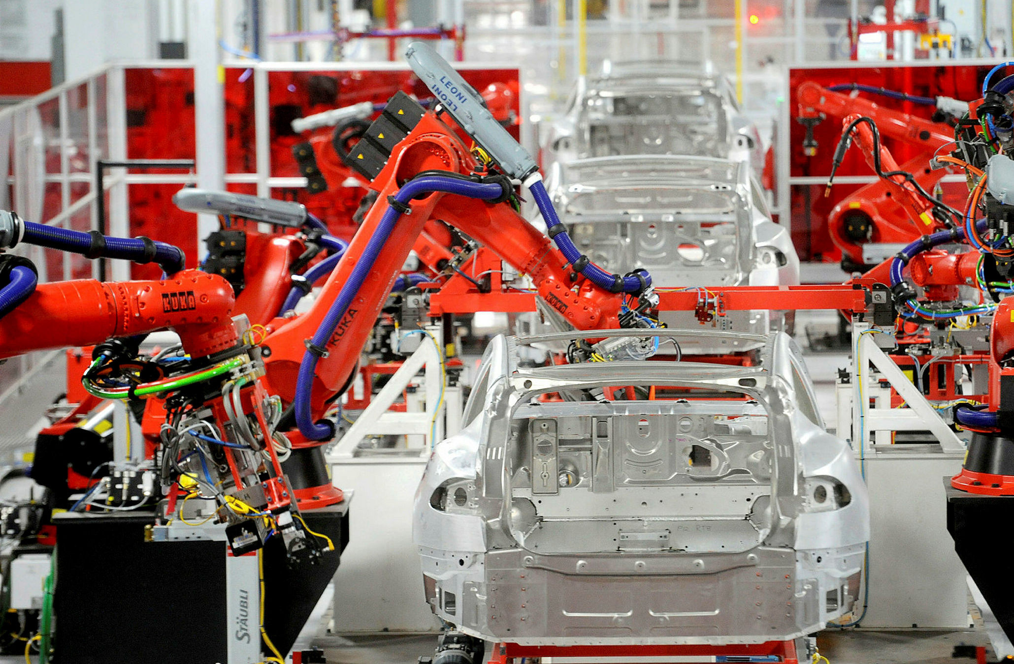
Victims of the 4th Industrial Revolution
Cashiers
Manufacturing Operatives

Slide 9
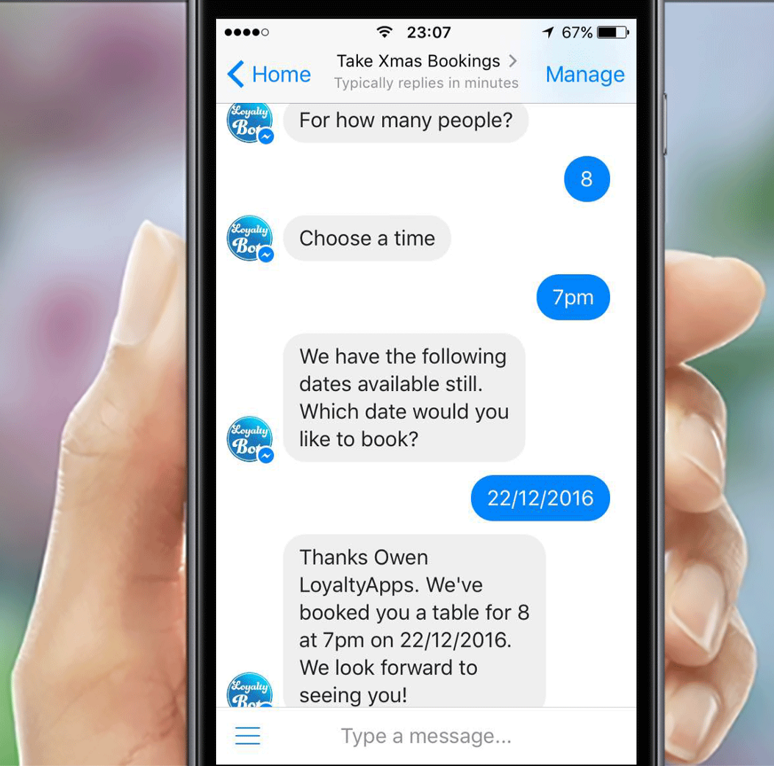

Victims of the 4th Industrial Revolution
Customer Service Advisors
Bank Tellers

Slide 10
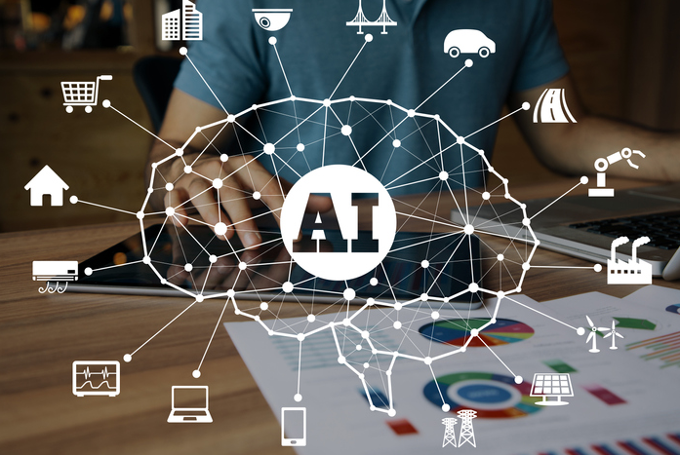
5th Industrial Revolution
Artificial Intelligence
Internet of Things
Big Data and Analytics
Renewable Energy and sustainable Technologies
Biotechnology and Genetic Engineering
Image courtesy of TechCrunch
Image courtesy of Shutterstock

Slide 11

IT Field - Any suggestion?
Software Engineering
Data Engineering
Product
Security
Cloud - Architecture and engineering
Embedded System Engineering
Blockchain – Architecture and engineering
Business Intelligence – Analyst and developer

Slide 12
4. Gartner Inc - August 2019 – March 2020
5.. Depository Trust & Clearing Corporation – Sept 2017 – August 2019
6. AstraZeneca – June 2015 – Sept 2017
7. SAP – Nov 2014 – June 2015
8. McAfee Inc – July 2010 – Oct 2014
9. Several others – April 2000 – July 2010
1. Hectogon - June 2015 - TILL DATE
2. IAG British Airways - March 2023 - TILL DATE
3. Several others – April 2020 – March 2023
My Career Story

Slide 13
My Startup Story
7. PSBS Partners – 1993 - 1997
6. Soji Tutorial College – 1997 - 2000
5. Manilla Royal Concept Limited – 2003 - 2007
1. AirSmat Inc - 2020 - Till Date
3. Hope Care Support Limited – 2018 – 2021
4. Sheeft Transport Limited – 2019 – 2020
2. MonyPot Limited - 2022 - Till Date
My Startup Story

Slide 14

Innovate

